Slide 1
Identify the types of input and output devices used in IT
Explain the types of I/O devices that support accessibility in IT
Analyse storage devices according to being fit for purpose for a given scenario
I/O devices
Discussion

Slide 2
HDD
Storage device | Adv | Disadv
HDD | HDDs offer a big storage capacity at relatively low cost. They are also considered a reliable storage method as they have a long life span and tend not to fail outright. | HDDs have a relatively slow read/write speed, particularly when compared to their main alternative, the Solid State Drive. They also have a number of moving parts, which means knocks can easily damage the device. This makes it generally a risky option as a portable storage device. They’re also not as portable as other options as they’re heavier and bulkier than many alternatives

Slide 3
SSD
Storage device | Adv | Disadv
SSD | SSDs have very fast read/write speeds, especially compared to hard disk drives. This makes it faster to turn on your computer, load programs and save files. They also consume less power than HDDs. This makes them very useful for devices that often run off of battery power, such as laptops. Because they have no moving parts, they are less likely to be damaged by knocks and bumps, which makes them useful as portable storage devices. | SSDs are quite a bit more expensive than HDDs. A 1 terabyte SSD will cost you over £200 (compared to under £50 for an HDD). Because of this heightened cost, this means that generally, SSDs will have a lower storage capacity than HDDs. SSDs have a finite number of writes before they no longer work. This makes them less useful for devices that require regular writing to the disk (like many servers).

Slide 4
USB
Storage device | Adv | Disadv
USB | USB flash drives are very portable storage devices, due to their small size, light-weight & easy connectivity to other devices (using a built-in USB connector). Much like SSDs, because they have no moving parts, this makes them durable and reliable as they’re unlikely to be damaged by knocks and bumps. As mentioned, the USB connector built into the device makes them highly compatible with devices, which usually include a USB interface. | Due to the devices small physical size, USB flash drives can be very easy to lose. Much like SSDs, USB flash drives have a finite amount of writes. This is less of a concern with USB though as you don’t usually write to a USB flash drive often enough for this to become an issue. USB flash drives have a low storage capacity. Up to 128gb is quite common, though you can get larger, but it quickly becomes very expensive.

Slide 5
SD Card
Storage device | Adv | Disadv
SD Card | SD cards are extremely small and portable, even compared to USB flash drives. This makes it very easy to transfer data between devices (as long as they have an SD card reader). Again, like other forms of flash memory, they are a reliable storage device that is less likely to take damage from bumps. Though they are flimsier than other flash storage due to their small size. | SD cards have a low storage capacity compared to other storage devices. 32-64 GB is common, though larger is possible, anything over 128 GB is expensive. There is quite a lot of variety in SD cards. SD, SDHC, SDXS are common, as well as mini and micro SD cards. There are also other types of flash memory card other than SD. This can lead to problems with compatibility with SD card readers.

Slide 6
Optical Disk
Storage device | Adv | Disadv
Optical Disk | The vast majority of personal computers, as well as many other types of digital devices, have optical disk drives and so can read the disks. They’re a small storage media, which makes them highly portable. This is why they’re used for distributing things like software and films. | An individual optical disk has quite a small storage capacity. A Blu-Ray can store up to 50GB of data. Optical disks are also easy to damage. They’re quite flimsy, and also are easy to scratch which can damage the data it is storing. Optical disks only work for a finite number of writes. CDRW disks, for example, can be written to around 1000 times.

Slide 7
Manual & Automatic data processing
Peripheral devices are used for input, storage & output. We’ve seen a wide variety of these sorts of devices, which have mostly been concerned with manual data entry. However, there are also many situations where automatic data entry is more appropriate.

Slide 8
Manual data processing
Manual data processing involves an individual entering data into the computer themselves, usually by typing on a keyboard, though it could be by clicking on objects with a mouse, using a touchscreen or giving voice commands.
We might use this for all sorts of reasons, such as:
A hotel clerk entering customer booking details using a keyboard to type data into a bookings database.
Marking examination papers or coursework by using a keyboard to type marks into a spreadsheet.
Inputting responses to a customer satisfaction survey by using a mouse to select options from a drop-down list or checkboxes.

Slide 9
Automatic data processing
Automatic data processing helps resolves these problems as the role of data entry is taken away from individual users. Instead, specialist devices will interpret data, converting from its physical source into digital data stored on the computer.
Examples of this include:
Optical mark readers that are used to enter data from pre-printed forms. This is used commonly for lottery tickets but also used to be popular with school registers.
Barcode readers for inputting product details automatically by scanning the barcode on the back of the device and matching it with a database.
Smart readers in homes to monitor electricity and gas usage and automatically send this data to the energy supplier for accurate billing.
Radio Frequency Identification (RFID) chips used for monitoring stock and even automatic collection of stock using robotics.

Slide 10
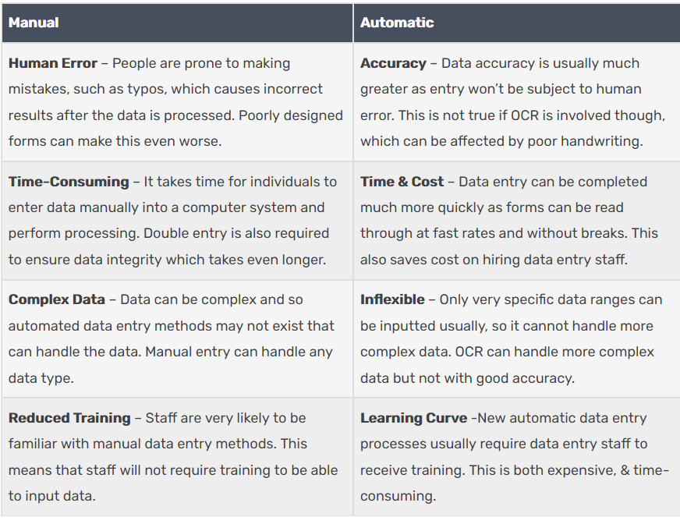
Automatic & Manual data processing comparison

